Slide 1

Employee data analysis using excel
STUDENT NAME:g.aswinkumar
REGISTER NO:22CM204 & asunm110312201228
DEPARTMENT:Commerce (General)
COLLEGE:Dharmamurthi Rao Bahadur Calavala Cunnan Chetty’s
Hindu College

Slide 2

Project title
EMPLOYEE SALARY ANALYSIS
USING EXCEL

Slide 3
AGENDA
1.Problem Statement
2.Project Overview
3.End Users
4.Our Solution And Propostion
5.Dataset Description
6.Modelling Approach
7.Results And Discussion
8.Conclusion

Slide 4
Problem statement
It present salary distributions across various roles or departments, but its current design hinders readability and clarity. The overlapping labels and lack of categorization make it difficult to draw meaningful insights from the data. There is a need for a more effective visualization that clearly differentiates the roles and departments, and perhaps introduces more data points like salary ranges or averages.

Slide 5
Project overview
The project aims to analyze and visualize salary data across various roles and departments within an organization. The goal is to create clear, insightful, and easily interpretable charts that can inform decision-making related to compensation, budgeting, and workforce planning

Slide 6
Who are the end users
Human Resources (HR) Department
Management and Executive
Finance Department
Recruitment Team
Employees (Potentially)
Consultants or Auditors
Board of Directors
:

Slide 7
Our solution and its value proposition
Solution:
Instant Assistance:
Get immediate help with a wide range of tasks, including data analysis, content creation, problem-solving, and more.
Versatility:
Whether you need help understanding complex data, generating creative content, or answering questions across various topics, this chat can assist.
Value Proposition:
Time Savings:
By using this chat, you can reduce the time spent on manual data analysis or content creation, allowing you to focus on more strategic tasks.
Accessibility:
This chat is available anytime, providing support whenever you need it without waiting for human intervention.

Slide 8
Dataset description
1.EMPOLYEE DETAILS-Kaggle.com
2.NAME-Text
3.GENDER-Female or Male
4-DEPARTMENT-Text
5-SALARY-Number

Slide 9
The ‘wow’ in our solution
The "wow" in this solution lies in its ability to transform raw salary data into actionable insights that can drive fairness, transparency, and strategic planning within the organization.
"Wow" Factors in the Solution;
Clear Salary Disparities Across Roles
Data-Driven Decision Making
Comprehensive Overview
User-Friendly Visualization
Potential for Further Analysis
Strategic HR Tool

Slide 10
modelling
1. Data Collection and Preparation
Data Source: Gather salary data from your organization's HR system or a similar database
2. Data Modeling
Regression Analysis (if applicable):
You could use linear regression to predict salary based on variables like experience, education, or department.
The model could also help identify factors contributing to salary discrepancies.
3. Presentation and Reporting
Reporting:
Create a detailed report that includes the bar chart along with insights and recommendations.
Stakeholder Communication:
Prepare a presentation for HR or leadership teams, emphasizing the most critical findings and proposed actions.

Slide 11
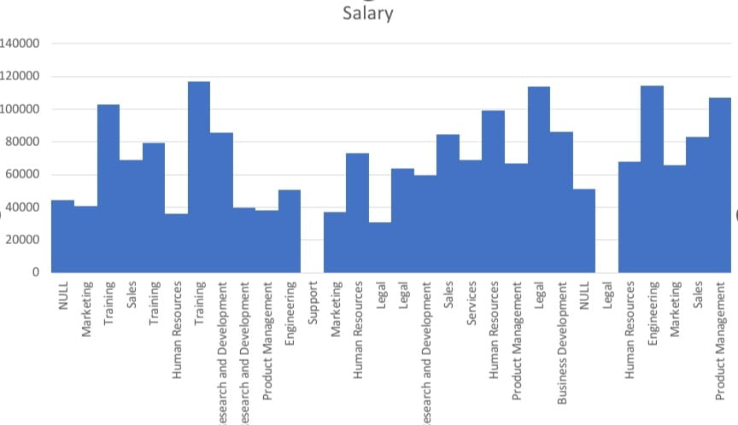
results

Slide 12
summary
.
1.To find the salary of the employee by using the excel
2.The results shown in the above graph
3. The chart provides a clear visual comparison of salaries, making it easy to identify which roles or departments have higher or lower compensation.
4. This data can be used to address salary disparities, ensure fair pay, and inform decisions related to budgeting and compensation planning

Slide 13
Discussion
Overview;
The chart provides a visual representation of the salary distribution across various job roles or departments within an organization. Each bar on the chart corresponds to a specific role or department, with the height of the bar indicating the average (or median) salary for that position.
There are noticeable differences in salary levels across different roles or departments. Some roles, such as those in product management or legal departments, appear to have higher salaries, while others, like certain administrative roles, are on the lower end.

Slide 14
conclusion
The salary distribution chart provides a clear and insightful visualization of how salaries vary across different job roles or departments within the organization. It highlights key disparities in compensation, enabling stakeholders to identify roles with significantly higher or lower pay. This information is crucial for ensuring fairness in compensation practices and aligning salaries with organizational goals and industry standards.

